Slide 1
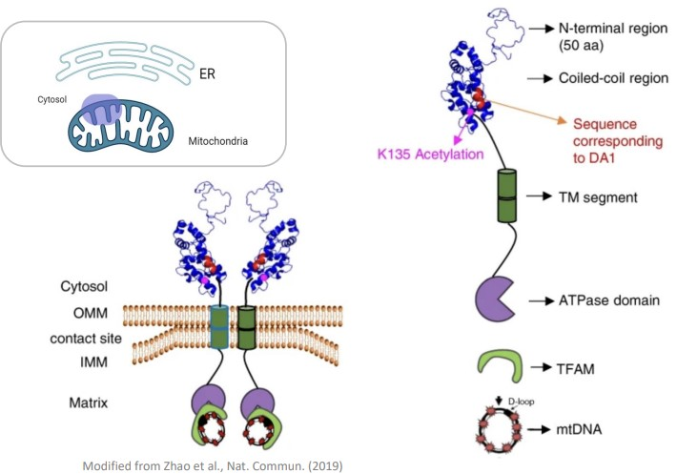
The role of AAA-ATPase ATAD3A in regulating mitochondrial architecture and its implications in disease
Alondra Torres-Gerena
Department of Biochemistry, Nebraska Redox Biology Center, University of Nebraska Lincoln, NE 68588.
PI: Oleh Khalimonchuk, Co-PI: Rodrigo Franco

Slide 2
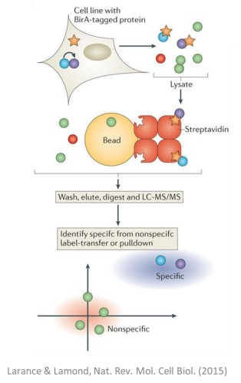
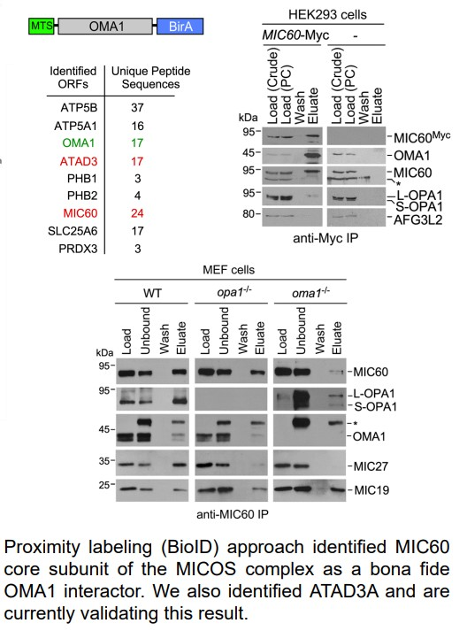
Does ATAD3A interact with mitochondrial OMA1, modulate membrane architecture during stress, and link the OMA1-DELE1-HRI signaling axis to mitochondrial membrane remodeling?

